Slide 1

Chapter 2
Processes & Threads

Slide 2
concurrent processes
We structure complex systems as sets of simpler activities, each represented as a sequential process. Processes can overlap or be concurrent, so as to reflect the concurrency inherent in the physical world, or to offload time-consuming tasks, or to manage communications or other devices.
Designing concurrent software can be complex and error prone. A rigorous engineering approach is essential.
Concept of a process as a sequence of actions.
Model processes as finite state machines.
Program processes as threads in Java.

Slide 3
processes and threads
Concepts: processes - units of sequential execution.
Models: finite state processes (FSP)
to model processes as sequences of actions.
labelled transition systems (LTS)
to analyse, display and animate behavior.
Practice: Java threads

Slide 4
2.1 Modeling Processes
Models are described using state machines, known as Labelled Transition Systems LTS. These are described textually as finite state processes (FSP) and displayed and analysed by the LTSA analysis tool.
LTS - graphical form
FSP - algebraic form

Slide 5
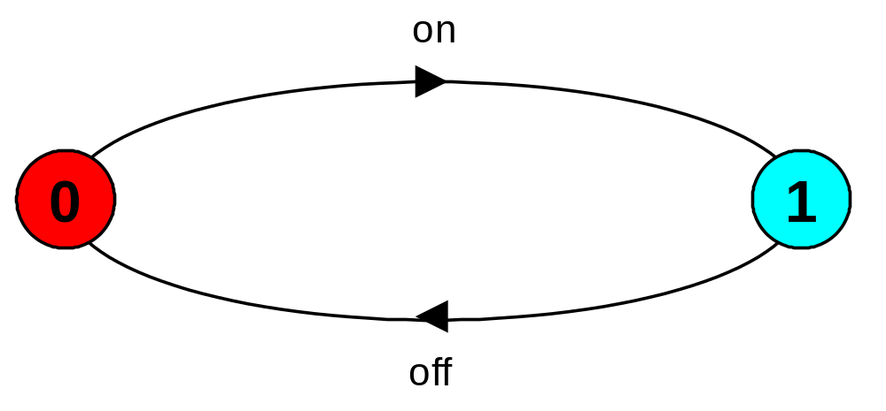
modeling processes
A process is the execution of a sequential program. It is modeled as a finite state machine which transits from state to state by executing a sequence of atomic actions.
a light switch LTS
a sequence of actions or trace
on→off→on→off→on→off→ ……….
Can finite state models produce infinite traces?

Slide 6
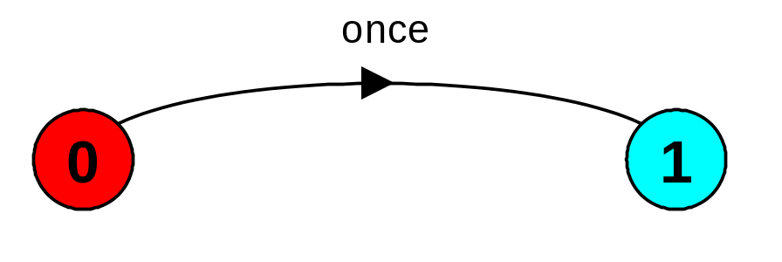
FSP - action prefix
  If x is an action and P a process then the action prefix (x-> P) describes a process that initially engages in the action x and then behaves exactly as described by P.
ONESHOT = (once -> STOP).
ONESHOT state machine
(terminating process)
Convention: actions begin with lowercase letters
PROCESSES begin with uppercase letters

Slide 7

FSP - action prefix & recursion
Repetitive behaviour uses recursion:
SWITCH = OFF,
OFF = (on -> ON),
ON = (off-> OFF).
Substituting to get a more succinct definition:
SWITCH = OFF,
OFF = (on ->(off->OFF)).
And again:
SWITCH = (on->off->SWITCH).

Slide 8
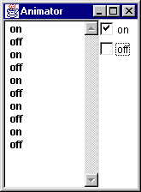
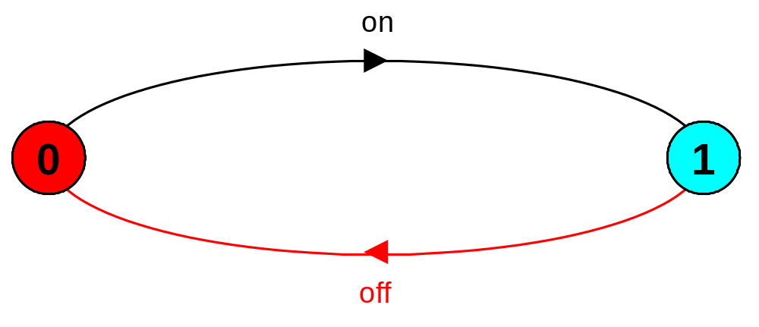
animation using LTSA
The LTSA animator can be used to produce a trace.
Ticked actions are eligible for selection.
In the LTS, the last action is highlighted in red.

Slide 9
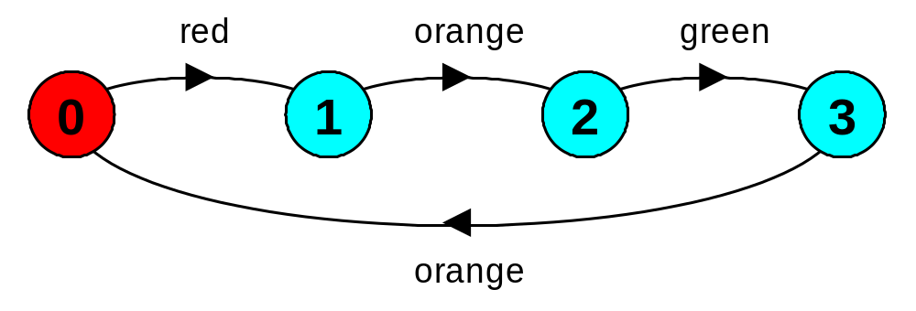
FSP - action prefix
FSP model of a traffic light :
TRAFFICLIGHT = (red->orange->green->orange
-> TRAFFICLIGHT).
LTS generated using LTSA:
Trace:
red→orange→green→orange→red→orange→green …

Slide 10
FSP - choice
  If x and y are actions then (x-> P | y-> Q) describes a process which initially engages in either of the actions x or y. After the first action has occurred, the subsequent behavior is described by P if the first action was x and Q if the first action was y.
Who or what makes the choice?
Is there a difference between input and output actions?

Slide 11
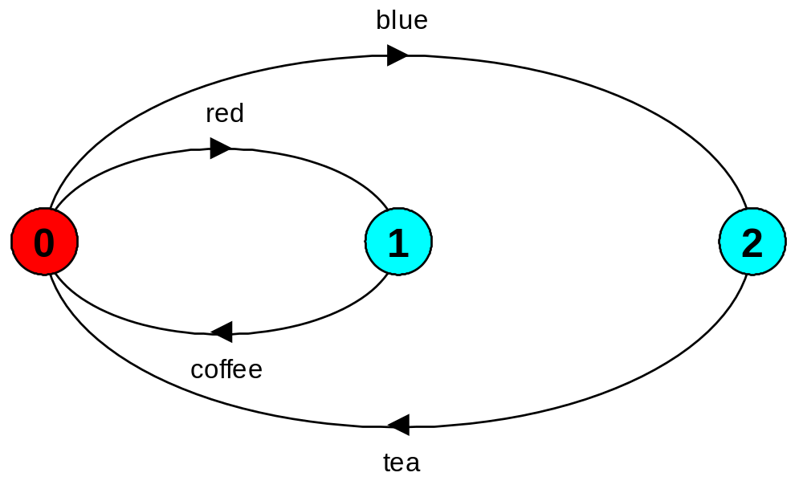
FSP - choice
FSP model of a drinks machine :
DRINKS = (red->coffee->DRINKS
|blue->tea->DRINKS
).
LTS generated using LTSA:
Possible traces?

Slide 12
FSP - choice
Task 1: Define FSP model of a machine that has four colored buttons (red, blue, green, yellow), only one (yellow) produces an output as an action “candy” :
FAULTY = ?
FAULTY = (red -> FAULTY
| blue -> FAULTY
| green -> FAULTY
| yellow -> candy -> Faulty
).
or Write down the LTS of the process:
FAULTY = ({red,blue,green}-> FAULTY
|yellow -> candy -> FAULTY
).

Slide 13
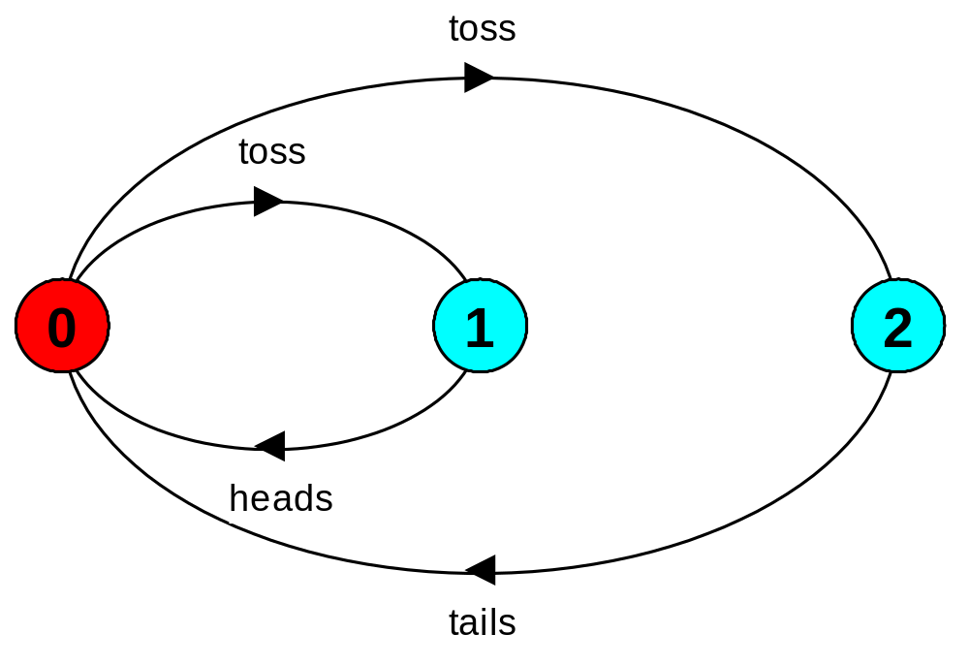
Non-deterministic choice
  Process (x-> P | x -> Q) describes a process which engages in x and then behaves as either P or Q.
COIN = (toss->HEADS|toss->TAILS),
HEADS= (heads->COIN),
TAILS= (tails->COIN).
Tossing a
coin.
Possible traces?

Slide 14
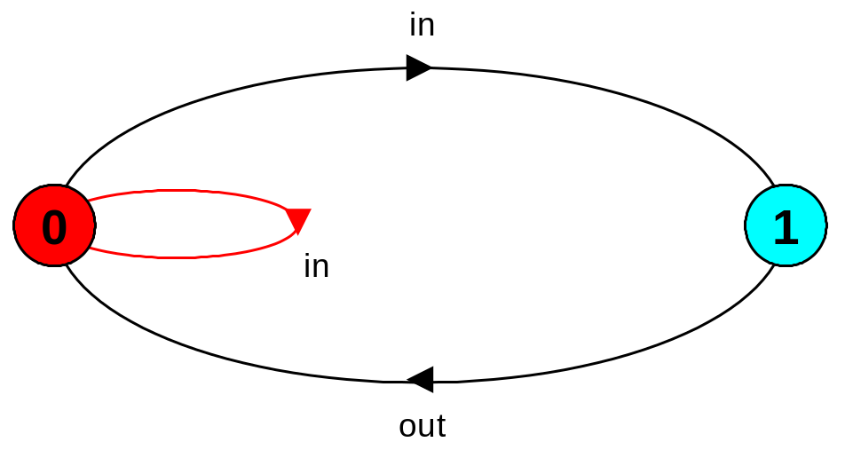
Modeling failure
How do we model an unreliable communication channel which accepts in actions and if a failure occurs produces no output, otherwise performs an out action?
Use non-determinism...
CHAN = (in->CHAN
|in->out->CHAN
).

Slide 15
FSP - indexed processes and actions
Single slot buffer that inputs a value in the range 0 to 3 and then outputs that value:
BUFF = (in[i:0..3]->out[i]-> BUFF).
equivalent to
BUFF = (in[0]->out[0]->BUFF
|in[1]->out[1]->BUFF
|in[2]->out[2]->BUFF
|in[3]->out[3]->BUFF
).
indexed actions generate labels of the form action.index
or using a process parameter with default value:
BUFF(N=3) = (in[i:0..N]->out[i]-> BUFF).

Slide 16
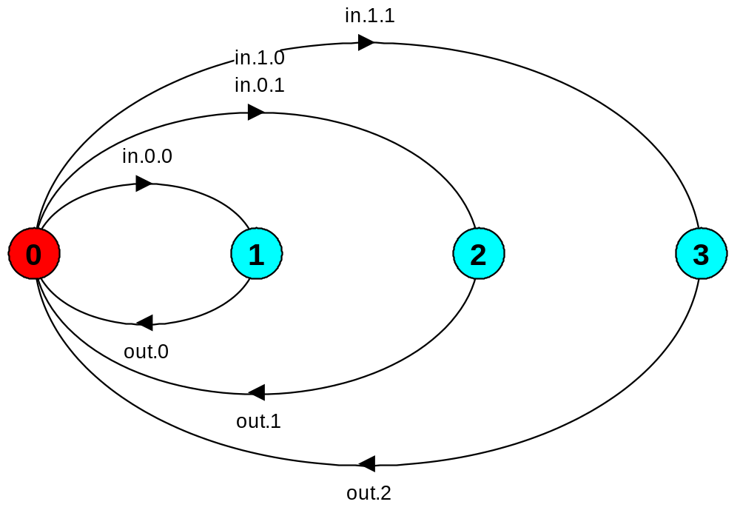
FSP - indexed processes and actions
Local indexed process definitions are equivalent to process definitions for each index value
index expressions to model calculation:
const N = 1
range T = 0..N
range R = 0..2*N
SUM = (in[a:T][b:T]->TOTAL[a+b]),
TOTAL[s:R] = (out[s]->SUM).

Slide 17
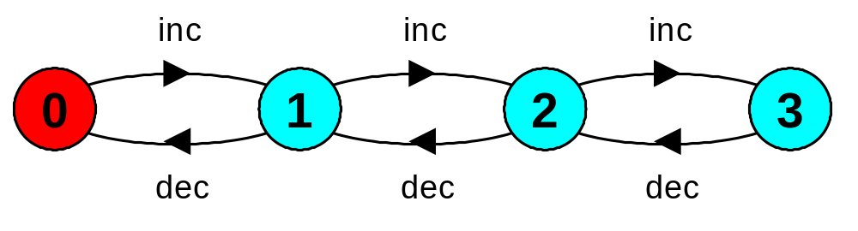
FSP - guarded actions
  The choice (when B x -> P | y -> Q) means that when the guard B is true then the actions x and y are both eligible to be chosen, otherwise if B is false then the action x cannot be chosen.
COUNT (N=3) = COUNT[0],
COUNT[i:0..N] = (when(i<N) inc->COUNT[i+1]
|when(i>0) dec->COUNT[i-1]
).

Slide 18
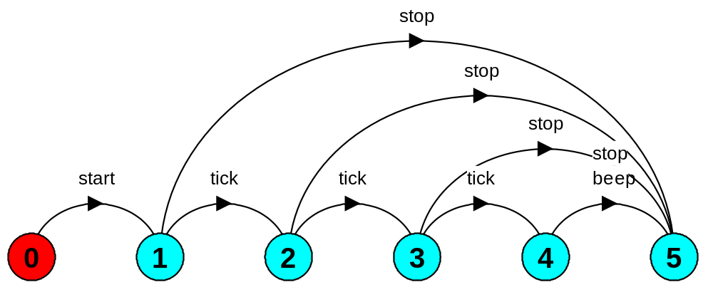
FSP - guarded actions
A countdown timer which beeps after N ticks, or can be stopped.
COUNTDOWN (N=3) = (start->COUNTDOWN[N]),
COUNTDOWN[i:0..N] =
(when(i>0) tick->COUNTDOWN[i-1]
|when(i==0)beep->STOP
|stop->STOP
).

Slide 19
FSP - guarded actions
What is the following FSP process equivalent to?
const False = 0
P = (when (False) doanything->P).
Answer:
STOP

Slide 20
FSP - process alphabets
  The alphabet of a process is the set of actions in which it can engage.
Process alphabets are implicitly defined by the actions in the process definition.
The alphabet of a process can be displayed using the LTSA alphabet window.
Process:
COUNTDOWN
Alphabet:
{ beep,
start,
stop,
tick
}

Slide 21
FSP - process alphabet extension
Alphabet extension can be used to extend the implicit alphabet of a process:
Alphabet of WRITER is the set {write[0..3]}
(we make use of alphabet extensions in later chapters)
WRITER = (write[1]->write[3]->WRITER)
+{write[0..3]}.

Slide 22

Revision & Wake-up Exercise
In FSP, model a process FILTER, that exhibits the following repetitive behavior:
inputs a value v between 0 and 5, but only outputs it if
v <= 2, otherwise it discards it.
FILTER = (in[v:0..5] -> DECIDE[v]),
DECIDE[v:0..5] = ( ? ).

Slide 23
2.2 Implementing processes
Modeling processes as finite state machines using FSP/LTS.
Implementing threads in Java.
Note: to avoid confusion, we use the term process when referring to the models, and thread when referring to the implementation in Java.

Slide 24
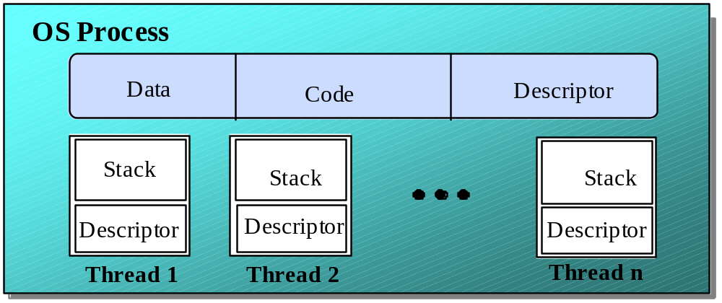
Implementing processes - the OS view
A (heavyweight) process in an operating system is represented by its code, data and the state of the machine registers, given in a descriptor. In order to support multiple (lightweight) threads of control, it has multiple stacks, one for each thread.

Slide 25
threads in Java
A Thread class manages a single sequential thread of control. Threads may be created and deleted dynamically.
The Thread class executes instructions from its method run(). The actual code executed depends on the implementation provided for run() in a derived class.
Thread
run()
class MyThread extends Thread {
public void run() {
//......
}
}
MyThread
run()
Creating a thread object:
Thread a = new MyThread();

Slide 26
threads in Java
Since Java does not permit multiple inheritance, we often implement the run() method in a class not derived from Thread but from the interface Runnable.
target
Runnable
Thread
run()
public interface
Runnable
{
public abstract
void run();
}
MyRun
class
MyRun
implements
Runnable
{
public
void run() {
run()
//
.....
}
}
Creating a thread object:
Thread b = new Thread(new MyRun());

Slide 27
thread life-cycle in Java
An overview of the life-cycle of a thread as state transitions:
new Thread()
start() causes the thread to call its run() method.
Created
start()
Alive
stop(), or
run() returns
stop()
Terminated
The predicate isAlive() can be
used to test if a thread has been started but not terminated. Once terminated, it cannot be restarted (cf. mortals).

Slide 28
thread alive states in Java
Once started, an alive thread has a number of substates :
Alive
Running
sleep()
suspend()
yield()
dispatch
suspend()
start()
Runnable
Non-Runnable
resume()
stop(), or
run() returns
Also, wait() makes a Thread Non-Runnable,
and notify() makes it Runnable
(used in later chapters).

Slide 29
Java thread lifecycle - an FSP specification
THREAD = CREATED,
CREATED = (start ->RUNNABLE
|stop ->TERMINATED),
RUNNING = ({suspend,sleep}->NON_RUNNABLE
|yield ->RUNNABLE
|{stop,end} ->TERMINATED
|run ->RUNNING),
RUNNABLE = (suspend ->NON_RUNNABLE
|dispatch ->RUNNING
|stop ->TERMINATED),
NON_RUNNABLE = (resume ->RUNNABLE
|stop ->TERMINATED),
TERMINATED = STOP.

Slide 30
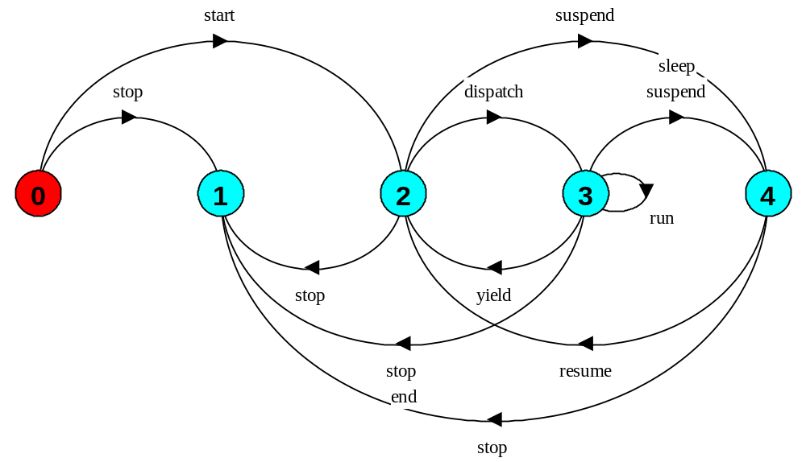
Java thread lifecycle - an FSP specification
end, run, dispatch are not methods of class Thread.
States 0 to 4 correspond to CREATED, TERMINATED, RUNNABLE, RUNNING, and NON-RUNNABLE respectively.

Slide 31
CountDown timer example
COUNTDOWN (N=3) = (start->COUNTDOWN[N]),
COUNTDOWN[i:0..N] =
(when(i>0) tick->COUNTDOWN[i-1]
|when(i==0)beep->STOP
|stop->STOP
).
Implementation in Java?

Slide 32
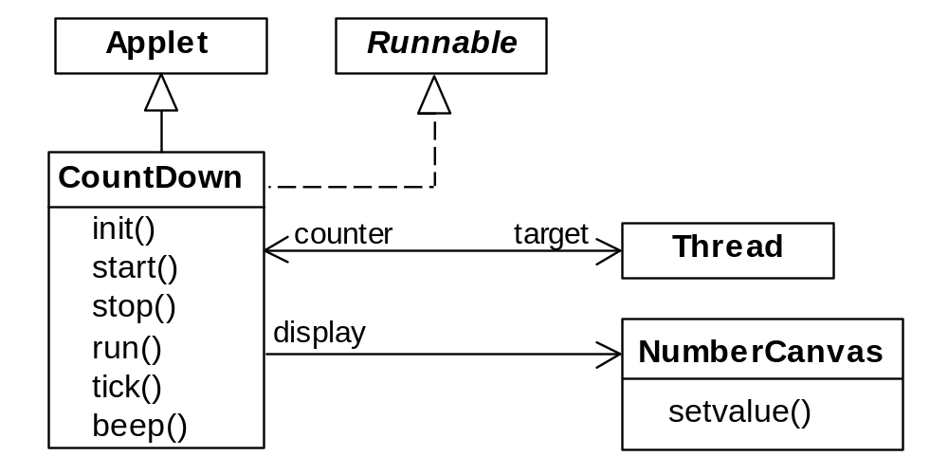
CountDown timer - class diagram
The class NumberCanvas provides the display canvas.
The class CountDown derives from Applet and contains the implementation of the run() method which is required by Thread.

Slide 33
CountDown class
public class CountDown extends Applet
implements Runnable {
Thread counter; int i;
final static int N = 10;
AudioClip beepSound, tickSound;
NumberCanvas display;
public void init() {...}
public void start() {...}
public void stop() {...}
public void run() {...}
private void tick() {...}
private void beep() {...}
}

Slide 34
CountDown class - start(), stop() and run()
COUNTDOWN Model
public void start() {
counter = new Thread(this);
i = N; counter.start();
}
public void stop() {
counter = null;
}
public void run() {
while(true) {
if (counter == null) return;
if (i>0) { tick(); --i; }
if (i==0) { beep(); return;}
}
}
start ->
stop ->
COUNTDOWN[i] process
recursion as a while loop
STOP
when(i>0) tick -> CD[i-1]
when(i==0)beep -> STOP
STOP when run() returns

Slide 35
CountDown
CountDown execution
init()
start()
new Thread(this)
counter thread
counter.start()
created
target.run()
stop()
tick()
alive
tick()
counter=null
terminated

Slide 36
Summary
Concepts
  process - unit of concurrency, execution of a program
Models
  LTS to model processes as state machines - sequences of atomic actions
  FSP to specify processes using prefix “->”, choice ” | ” and recursion.
Practice
  Java threads to implement processes.
  Thread lifecycle - created, running, runnable, non-runnable, terminated.

